Slide 1
Polynomials with many
Rational Preperiodic Points
Aaron Kim
Mara-Ioana Postolache
Vivian Szeto
Prof. Holly Krieger

Slide 2

Part 0: Motivation

Slide 3

Motivation: Arithmetic geometry
Arithmetic geometry : Study of integer solutions to integer-coefficient polynomial equations (Diophantine equations) using geometry
For example…

Slide 4
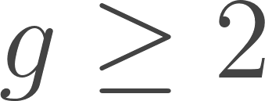
Motivation: Arithmetic geometry
Solutions of equation above ↔ Rational points on the following curve:
(Faltings’ theorem) Curves of genus only have finitely many rat’l points
Geometry ↔ Arithmetic

Slide 5

Motivation: Arithmetic geometry
Curves of genus 0 or 1 instead have group structure on the rat’l points
Geometry ↔ Arithmetic ↔ Algebra
(Mazur-Morel) For all curves of genus 1, rat’l torsion pts have order
“ Uniform boundedness for torsion pts ”
(algebraic)
↓
↑
(arithmetic)

Slide 6
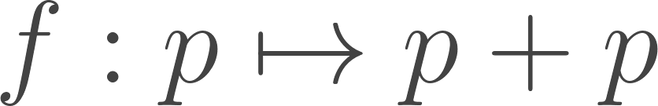

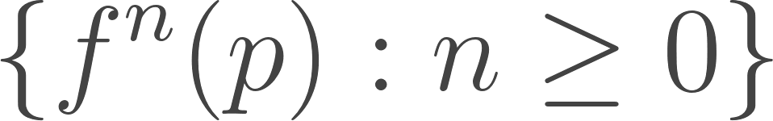


Motivation: Uniform boundedness conjecture
This problem can be translated into context of dynamics; consider
is a torsion point ↔ is preperiodic (ie. is finite)
Uniform boundedness conjecture for preperiodic points:
“ For every polynomial of fixed degree , number of rat’l preperiodic pts is uniformly bounded above by some ”
(dynamics)
(arithmetic)

Slide 7

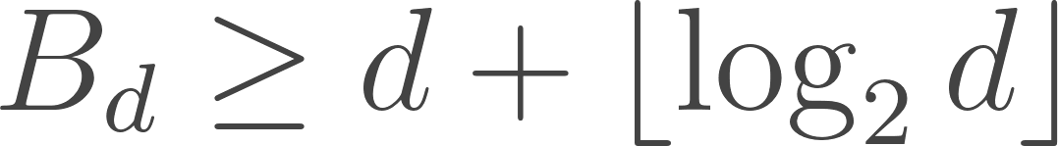

Dynamical compression
Question: If is actually finite, how large could it possibly be?
(Doyle, Hyde)
Idea: Using lattice theory, prove existence of integer-valued polynomial of degree that exhibits “ dynamical compression ”
Our work (Part 1): How much can dynamical compression be improved?

Slide 8

In higher dimensions
Uniform boundedness conjecture can be studied in higher dimensions (polynomials of two or more variables) - very poorly understood
Our work (Part 2): Consider specific family “Hénon maps” of polynomial maps
Study their dynamical behaviour - very long cycles!

Slide 9
Part 1: Polynomials in One Variable

Slide 10
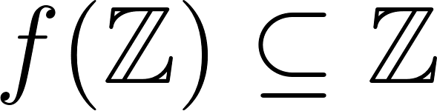
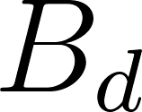
Starting point: dynamical compression
Why?
all of these integers must be preperiodic!
Further restriction: consider degree to be at least 2!
USE:
polynomial f of fixed degree, with large n
many preperiodic points, so some lower bound on conjectured value
⇒

Slide 11
What Doyle and Hyde did
Note: We can always find f of degree at most d such that
(by polynomial interpolation).
Proved the existence of polynomials f of degree between 2 and d such that
And explicitly constructed a family of polynomials of degree d with

Slide 12
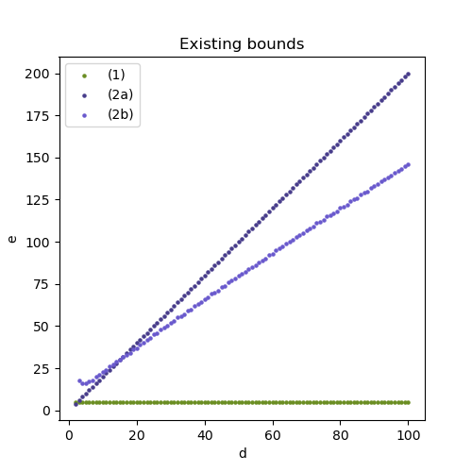
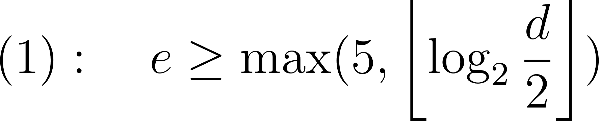
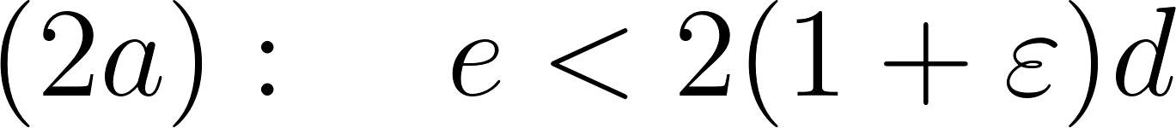
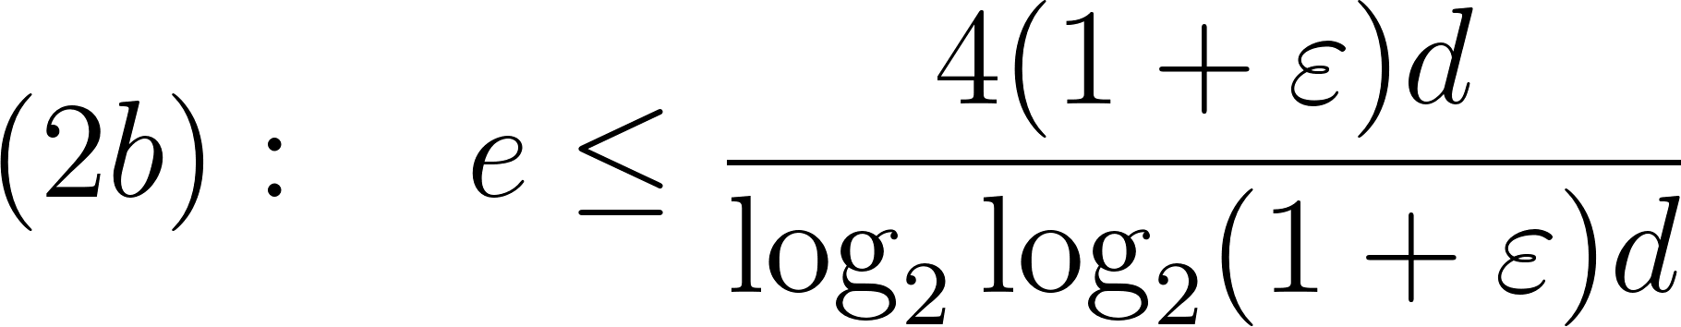
Existing bounds on e:
Lower bounds
For any d≥2:
Upper bounds
For any 𝛆>0, if we consider d sufficiently large, then we must have:

Slide 13
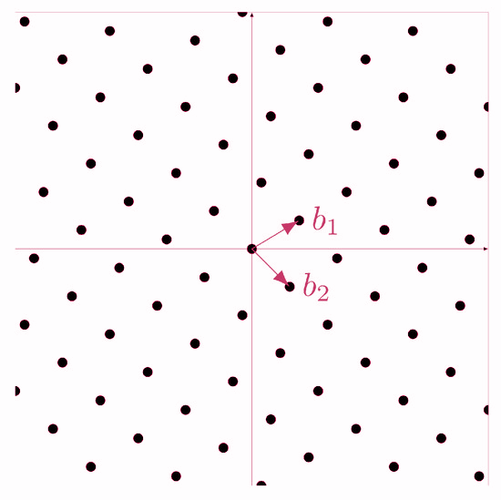
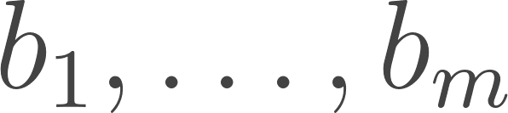
First, what is a lattice?
A lattice is the set of points in ℝ^{n} which can be obtained as integer linear combinations of some basis vectors
The most basic example of a lattice is

Slide 14
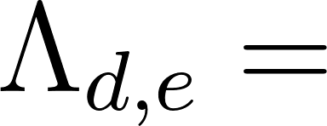
Ok, but what makes lattices useful?
lattice describing the space of all integer-valued polynomials of degree at most d
In this lattice, vectors that are short enough correspond to polynomials achieving dynamical compression:
So finding some short vectors should give us some good candidates for the polynomials!
THE CATCH:
The problem of short lattice vectors is difficult
(hard enough that it pops up in cryptography)

Slide 15
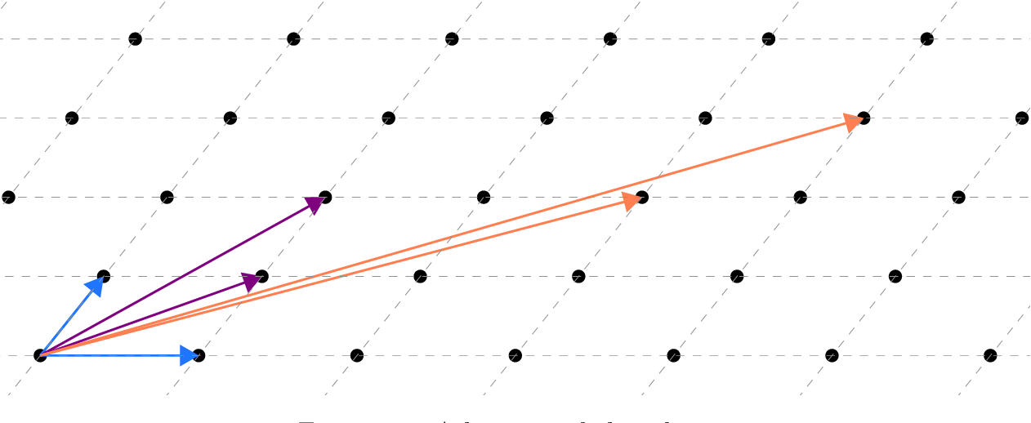
Why is the problem so difficult?
The basis itself doesn’t immediately tell you what the short vectors are:
It is computationally expensive to determine these explicitly.
However, basis reduction can help bound the lengths of these short vectors.

Slide 16
Let’s still search for short vectors explicitly…
It may take a lot of time for large d, but it’s decent for d≤15.
By looking at all the lattice vectors shorter than a certain value, we can find all the polynomials with dynamical compression.
Filtering out all the linear polynomials, we can explicitly compute the maximum value of e while maintaining dynamical compression.
d | e
2,4 | 5
3,5,6,7,8,11, 12,13,14,15 | 7
9,10 | 9

Slide 17
Basis Reduction
What we’d like: some form of Gram-Schmidt
The issue: the integers are not a field
Regardless, algorithms exist approximating this, and they give a basis that is almost orthogonal and has basis vectors relatively short.
Furthermore:
length of reduced basis vectors
bounds on how short the lattice vectors can be
⇒
So we can use the reduced basis to determine how good polynomials can be at dynamical compression!

Slide 18
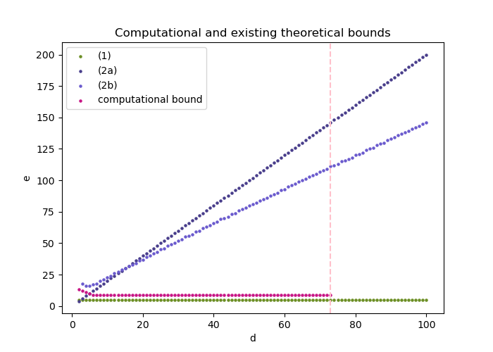
What does the lattice computation give us?
Doyle-Hyde:
e can be as high as green
Previous upper bounds:
e must be at most blue
Our computation:
e must be at most pink
(Computation only feasible for d<74)

Slide 19
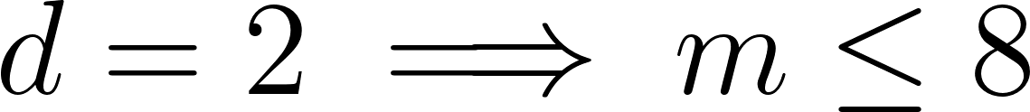
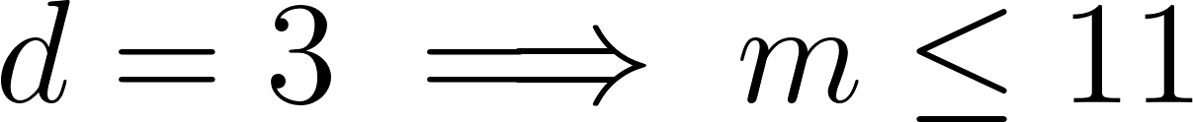
Optimality for d=2 and d=3
Recall dynamical compression:
Then, for f of degree d, we have:
( e ≤ 5 )
( e ≤ 7 )
There is one polynomial (up to translations) achieving equality for each of the RHS.
Hope for extending the result to larger d?
Not really… :(

Slide 20


Part 2: Hénon Maps with Long Cycles
I’m a great blue heron...

Slide 21
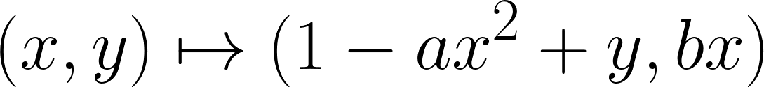
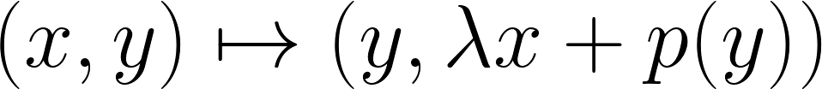
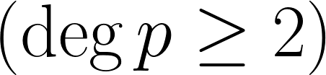
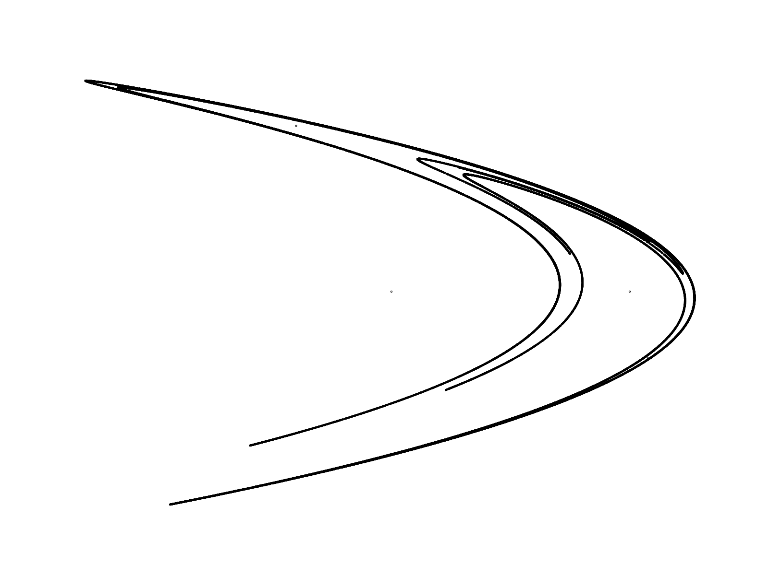

What’s a Hénon Map?
(by Hénon):
(ours):
I’m Michel Hénon
(1931-2013)...
Notes:
https://editor.codecogs.com/
The Henon map as usually defined.
$(x,y) \mapsto (1-ax^2+y,bx)$.
Responsible for pretty pictures associated with Henon maps
The classical Henon map (a = 1.4, b = 0.3) has the property that either points converge to a strange attractor, or diverge to infinity
The image is the strange attractor: it’s a fractal
Alternate formulation and generalization of Henon map
$(x,y) \mapsto (y,\lambda x+p(y))$
$(\deg p \geq 2)$
What we are looking at in this project
The map which we care about the dynamics of

Slide 22
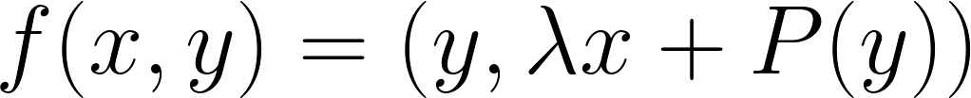
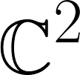
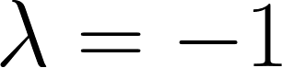

What’s a Hénon Map? Pt. 2
Boring!
elementary automorphism:
Hénon map:
Fact: any polynomial automorphism of
is conjugate to either:
an elementary automorphism
a composition of finitely many Hénon maps
For us:
,
integer-valued
Notes:
Dynamically interesting: any polynomial automorphism of C^2 is conjugate to either an “elementary automorphism” or a Henon map
Add images! This is the most important part.
We’re gonna hope to study these by studying just a subset, like we’re doing for the 1D case.
How about Lambda = -1, and p(y) being integer-valued?

Slide 23
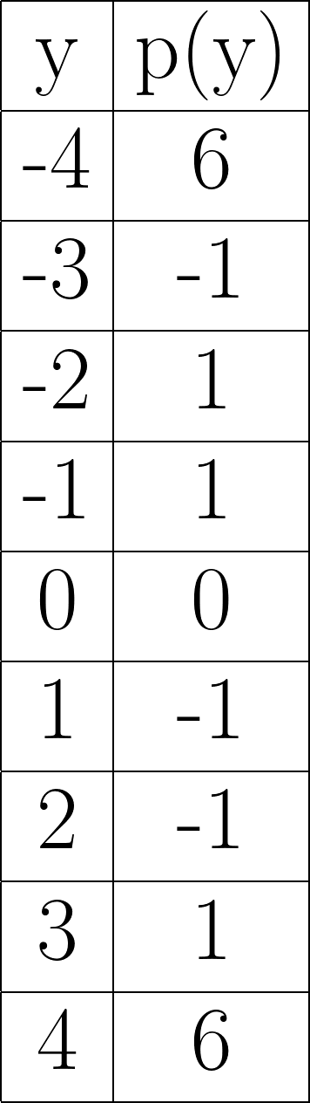
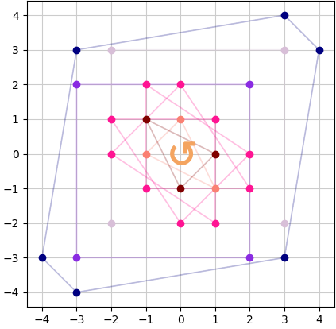
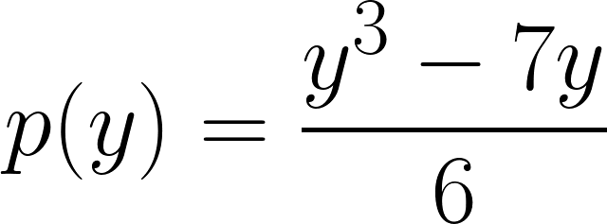
Example
← there’s a
10-cycle!

Slide 24
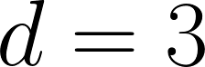
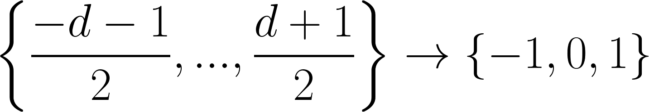
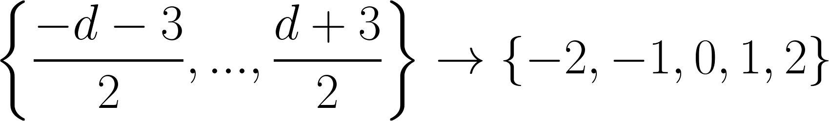
Family: “Trig-Approximating” Polynomials
A family of degree d (d odd, ≥3) polynomials that sends:
d+2 integers!
d+4 integers!
Notes:
These polynomials were obvious to check. In fact, we
This is a nice family of polynomials that Doyle and Hyde presented in their one-dimensional paper - it sends a large set of integers to {-1, 0, 1}

Slide 25
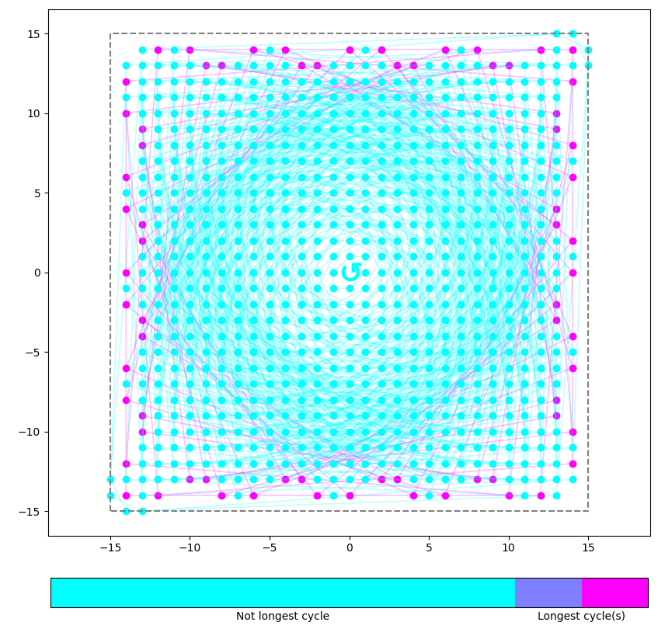
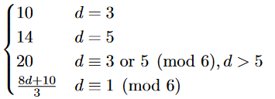
Family: “Trig-Approximating” Polynomials
Longest cycle of the Hénon maps:

Slide 26
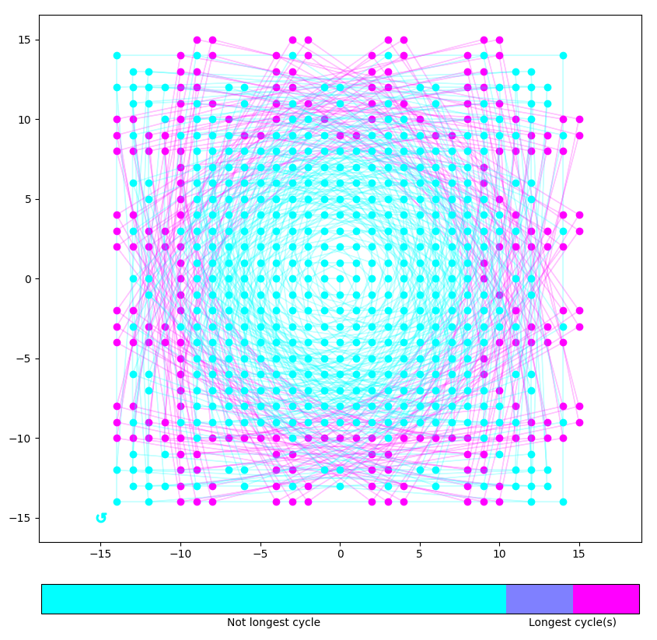
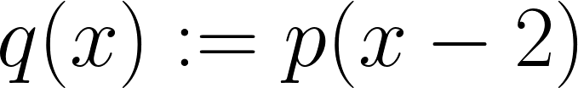
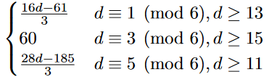
Family: “Shifted Trig-Approx”
Where p is the trig-approximating polynomial.
Longest cycle of the Hénon maps:
D = 29

Slide 27
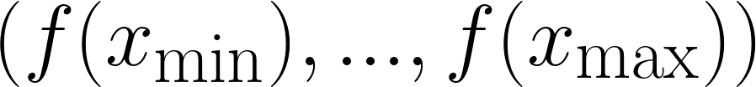
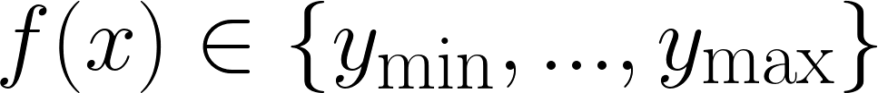
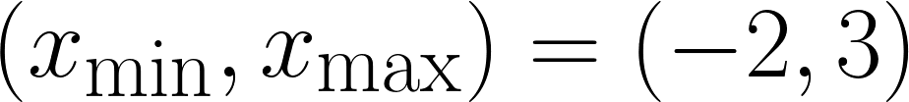
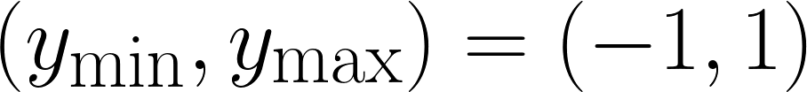
Searching for better Hénon maps
Consider the polynomial f which interpolates specified values
where each
Example search:
Notes:
We can check each polynomial p which interpolates
(y_1, y_2, …, y_d+1) where y_i is in e.g. {-1,0,1}, or {-2, -1, 0, 1, 2}.
→ The number of polynomials we have to check increases exponentially!
We can only do this for small d.

Slide 28
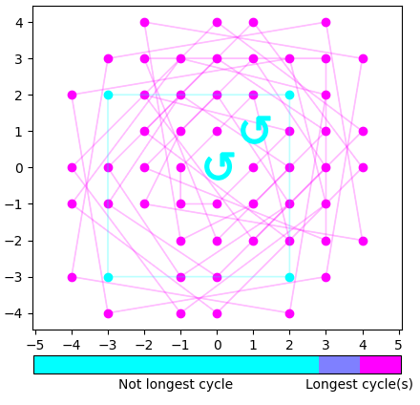
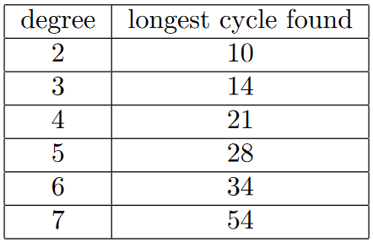
Results: Best overall (that we found)
← (best degree 7 polynomial)

Slide 29
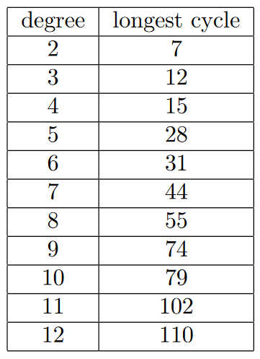
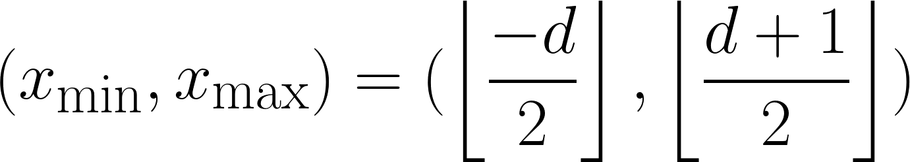
Results: Limited search space

Slide 30
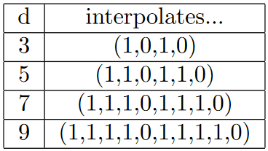
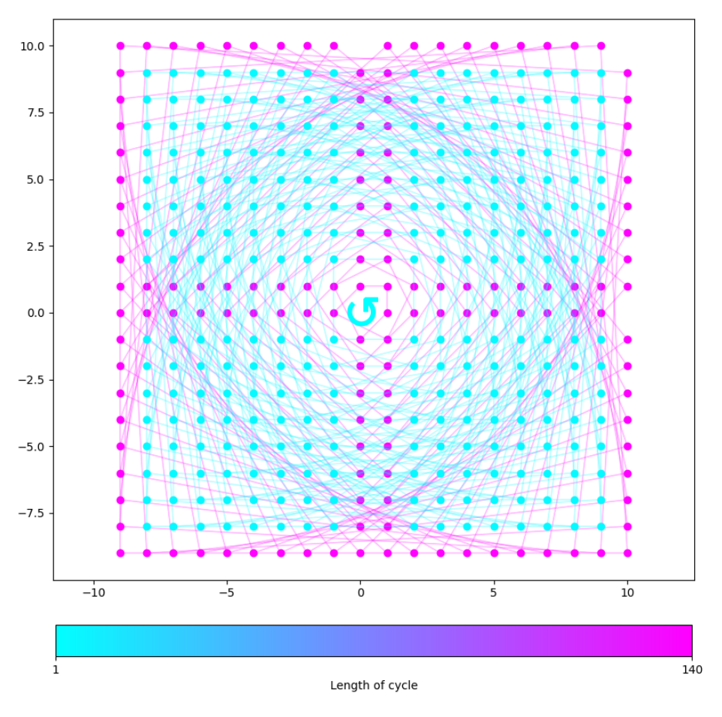
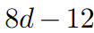

Results: New Family 1
Longest cycle:
(for all odd )
← (degree 19)

Slide 31
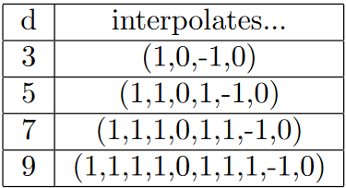
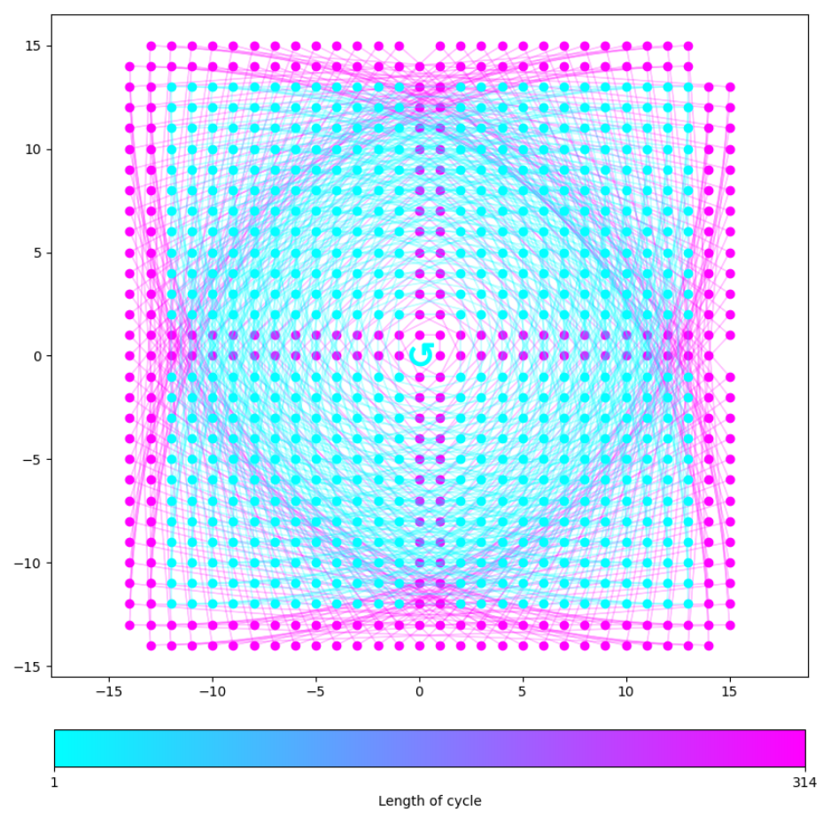
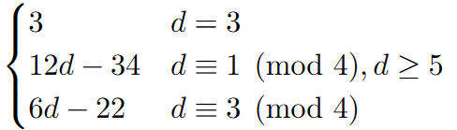
Results: New Family 2
Longest cycle:
← (degree 29)

Slide 32
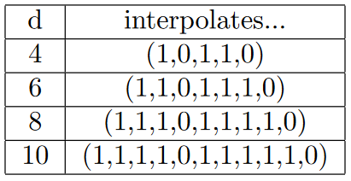


Results: New Family 3
Longest cycle:
← (degree 28)

Slide 33
Questions we didn’t have time for
Greater-than-linear growth?
Does our restriction still produce the “best” examples?
General theoretical results?

Slide 34
Part 3: Conclusion

Slide 35


Summary: Part 1 (Dynamical compression)
Uniform boundedness conjecture: is finite for all
Doyle-Hyde: Considering dynamical compression, must be at least
This is done using lattice theory!

Slide 36


Summary: Part 1 (Dynamical compression)
Using lattice reduction computation, showed dynamical compression cannot do much better than Doyle-Hyde (for small enough )
Theoretically, can prove optimal dynamical compression for
Further questions…
Prove our computational results theoretically?
Dynamical compression on other number fields?

Slide 37


Summary: Part 2 (Hénon maps)
Motivated from Doyle-Hyde, we consider dynamics of Hénon map:
where is dynamically compressing
Lots of long cycles with length linear in
By shifting, even longer cycles with linear length!

Slide 38
Summary: Part 2 (Hénon maps)
Using brute force search, found new family of Hénon maps with even longer cycles with linear length!
Further questions:
Polynomial Hénon maps with cycle length greater than linear?
General polynomial automorphisms?

Slide 39

THANK YOU FOR LISTENING
Questions?

